Slide 1

Developing Full Stack solutions with C# and ASP.NET Core 3.0
Scott Dockendorf
Chief Technology Officer, Remote Operations
JuLY 16, 2019

Slide 2
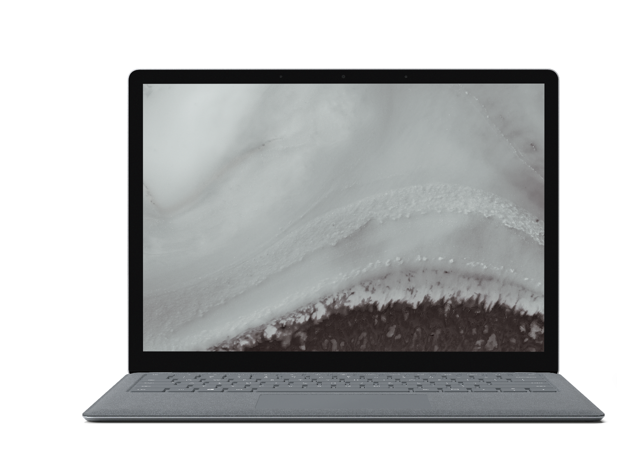
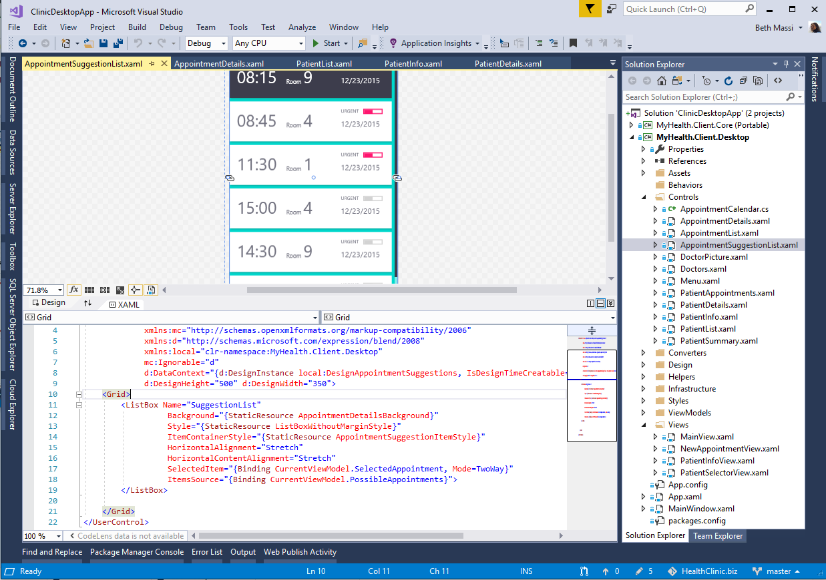
ANNOUNCING
.NET Core 3.0 Preview 6
Windows desktop support with WPF and WinForms, also open source
Flexible deployment, side-by-side support and self-contained EXEs
Full-stack web development with C# and Razor
Significant performance improvements
New C# language features for productivity and less errors
IoT (https://github.com/dotnet/iot) & AI via ML.NET (https://bit.ly/2HOvxSU)

Slide 3



.NET Core 3.0: A full stack solution
Client
Frontend
Backend
http://..
gRPC
gRPC
Worker
ASP.NET Core
Blazor
Components
SPA (JavaScript)
MVC / Razor Pages
Web APIs
SignalR
Security & identity
Worker services
gRPC

Slide 4

Full-stack, Client Web App C#/.net Core Application
?
API
Client App
ASP.NET
Core

Slide 5
Full-stack, Client Web App C#/.net Core Application
http://..
API
Client App
ASP.NET
Core

Slide 6
Full-stack, Client Web App C#/.net Core Application
http://..
gRPC
API
Client App
ASP.NET
Core

Slide 7
Full-stack, Client Web App C#/.net Core Application
http://..
gRPC
API
Client App
Worker
ASP.NET
Core

Slide 8
Full-stack, Client Web App C#/.net Core Application
http://..
gRPC
API
Client App
gRPC
Worker
ASP.NET
Core

Slide 9
Let’s start with Blazor
http://..
gRPC
API
Client App
gRPC
Worker
ASP.NET
Core

Slide 10

Blazor
Build client-side web UI with .NET instead of JavaScript
Call into JavaScript libraries & browser APIs as needed
Write reusable web UI components with C# and Razor
Share .NET code with both the client and the server
Blazor for WebAssembly now in official preview!

Slide 11

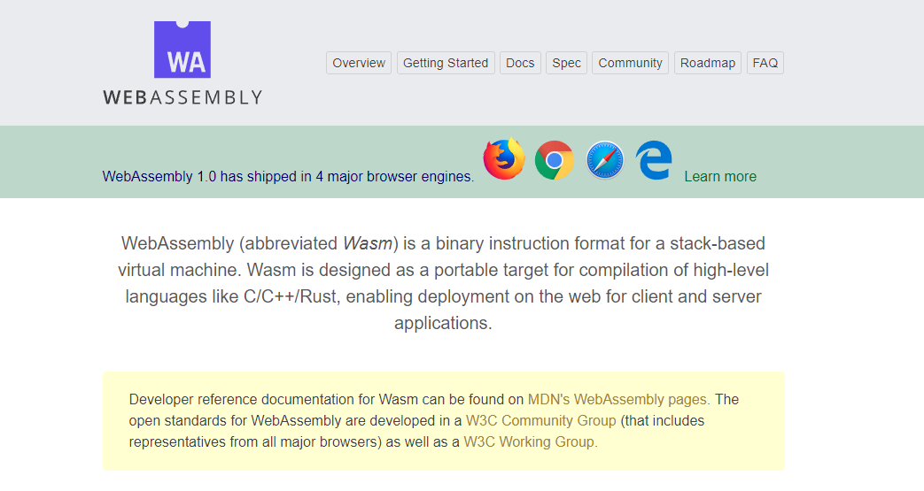
WebAssembly.org
Documentation: https://webassembly.org/docs/high-level-goals/

Slide 12






WebAssembly Working Group https://bit.ly/32yDOCP
Members from browser industry leaders:
… other tech giants:
… and more.

Slide 13


Blazor on client or server
Client-side
Server-side
https://...
https...
ASP.NET Core
Razor Components
DOM
SignalR
DOM
.NET
WebAssembly
Razor Components
.NET
Future
.NET Core 3.0

Slide 14
Machine Configuration To Run Blazor (as of 7/16/2019)
Install Visual Studio 2019 v16.2 Preview 3 https://visualstudio.microsoft.com/vs/preview/
Install .net Core 3.0 SDK Preview 6 https://dotnet.microsoft.com/download/dotnet-core/3.0
Install Blazor Preview 6 https://marketplace.visualstudio.com/items?itemName=aspnet.blazor
Install Blazor Templates (Command-line) dotnet new -i Microsoft.AspNetCore.Blazor.Templates::3.0.0-preview6.19307.2
Blazor Reference –
https://docs.microsoft.com/en-us/aspnet/core/blazor/get-started?view=aspnetcore-3.0&tabs=visual-studio

Slide 15
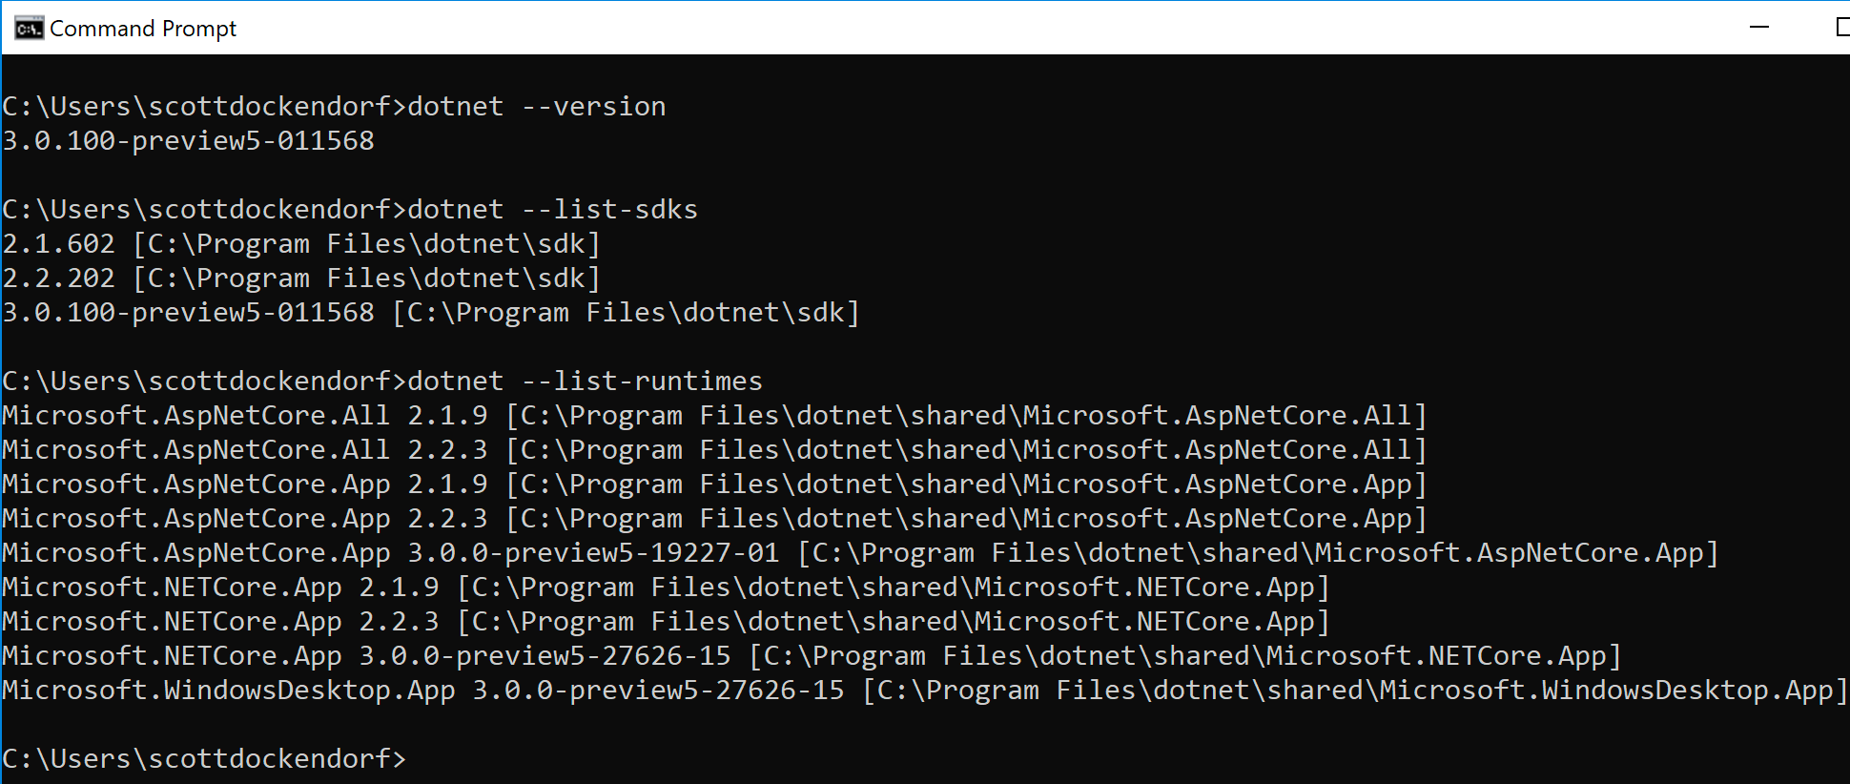
Confirm SDK Installed Correctly
dotnet -–version dotnet -–list–sdks dotnet -–list-runtimes

Slide 16
Demo
EXPLORE CLIENT-SIDE Blazor TEMPLATE

Slide 17
Now let’s explore worker processes
http://..
gRPC
API
Client App
gRPC
Worker
ASP.NET
Core

Slide 18
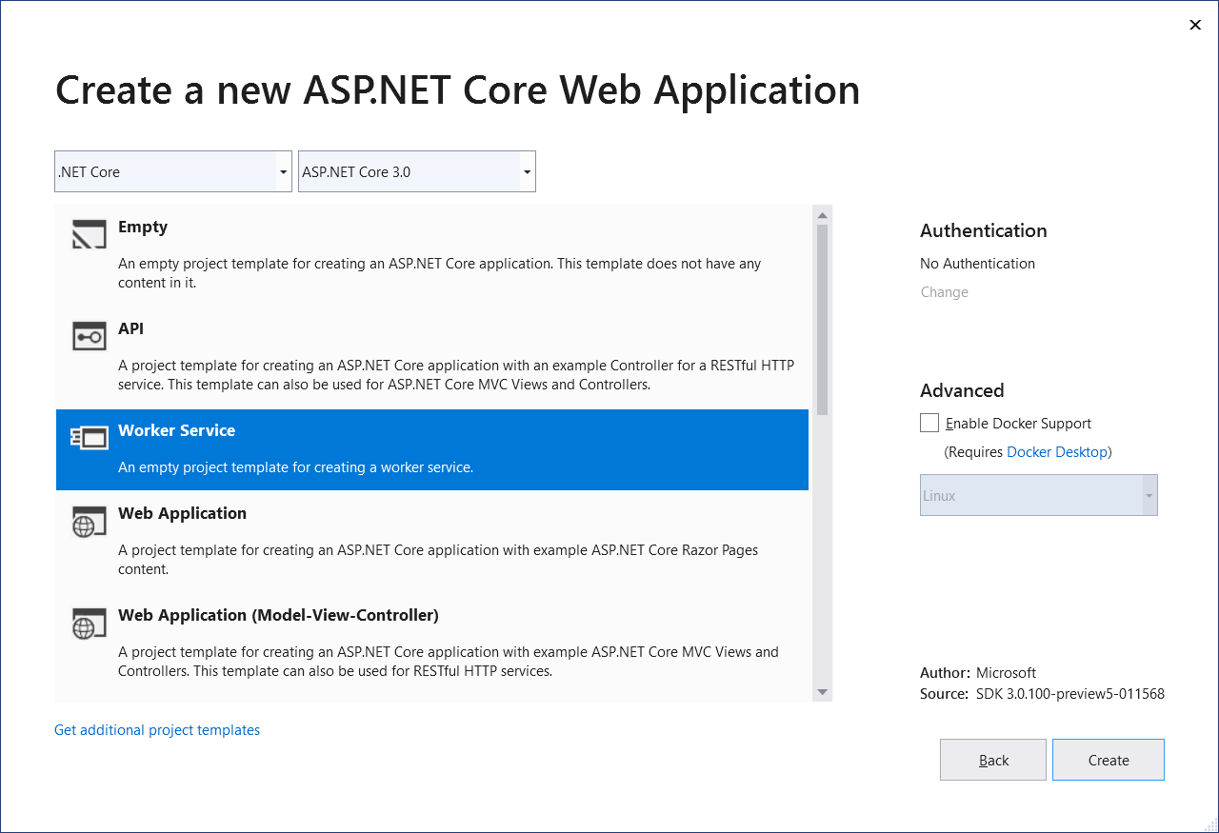
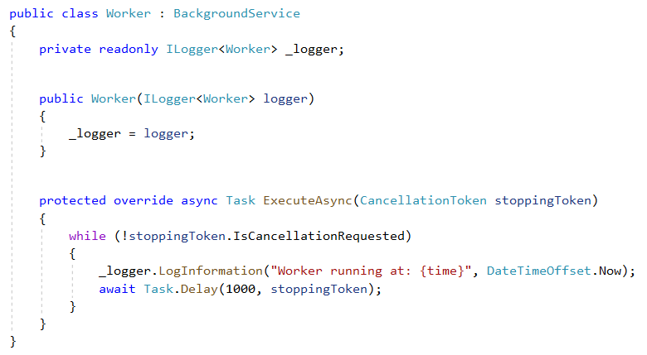
Worker services
New Worker service template to build long-running worker processes
Integrates with .net core services such as configuration, logging, dependency injection
Host as Windows service, Linux systemd, Azure WebJobs, Docker containers

Slide 19
Demo
EXPLORE Worker service TEMPLATE

Slide 20
Let’s explore gRPC
http://..
gRPC
API
Client App
gRPC
Worker
ASP.NET
Core

Slide 21

What is gRPC
gRPC is
modern open source high performance RPC framework that can run in any environment
efficiently connect services in and across data centers with pluggable support for load balancing, tracing, health checking and authentication
applicable in last mile of distributed computing to connect devices, mobile applications and browsers to backend services
USE CASES
Efficiently connecting polyglot services in microservices style architecture
Connecting mobile devices, browser clients to backend services
Generating efficient client libraries
Source: https://grpc.io/about

Slide 22
gRPC Important Concepts
Interoperability: Client libraries in 10 languages C#, C/C++, Dart, Go, Java, Node.js, PHP, Python, Ruby
Protobuf (aka “Protocol buffers”) as interface design language
Highly efficient on wire and with a simple service definition framework
Bi-directional streaming with http/2 based transport
Pluggable auth, tracing, load balancing and health checking
Source: https://grpc.io/about

Slide 23
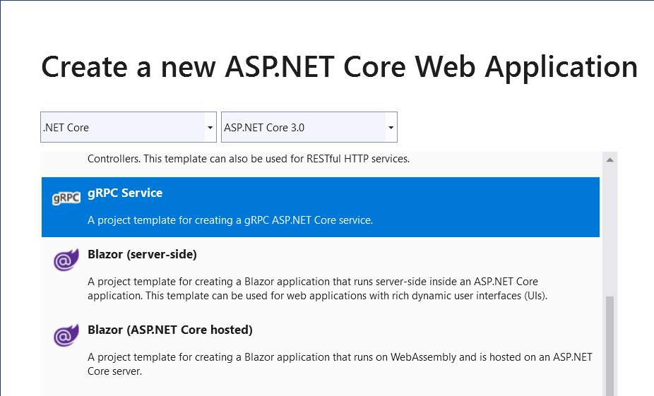
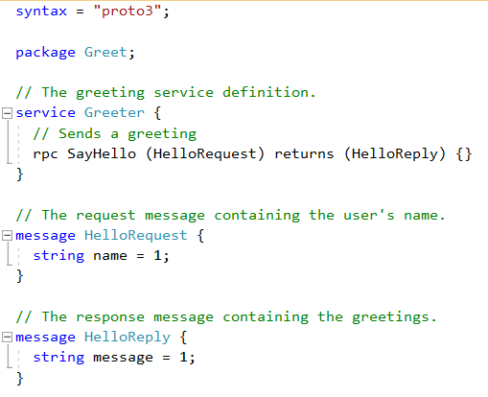
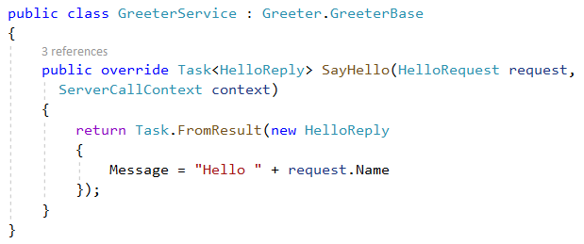
gRPC in C# with Visual Studio 2019

Slide 24
Final Demo – Order Management App
http://..
API
gRPC
Client App
gRPC
SignalR
Worker
ASP.NET
Core

Slide 25
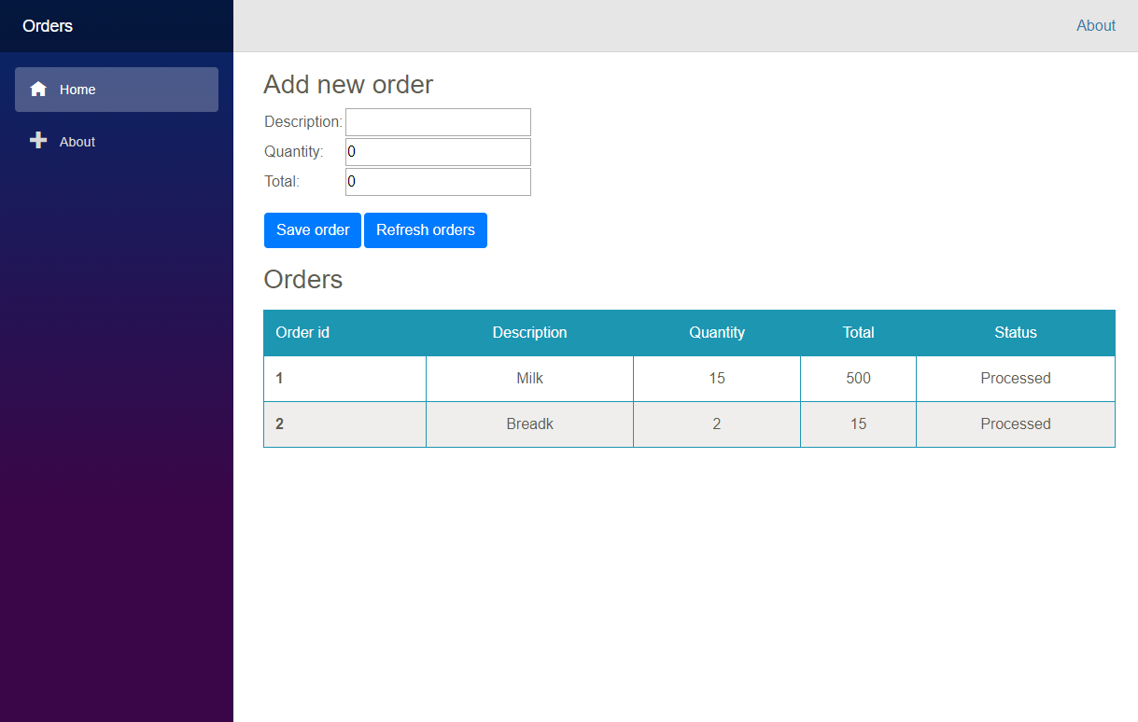
Let’s build an order management app!

Slide 26
Demo
The full architecture

Slide 27
Also new in ASP.NET Core 3.0
Blazor (server-side)
gRPC
Worker
Simplified shared framework
IdentityServer
API code generation
Endpoint routing integration
C# 8 in Razor & MVC
JSON
Windows service support
SignalR auto-reconnect, streaming
SignalR C++ client*
Event counters*
Certificate & Kerberos authentication*
Performance
*Coming soon!

Slide 28
.net Core 3.0 Schedule
Preview 6 - Now available!
Preview 7 (go-live) - July
Preview 8 (go-live) - Aug
GA - Sept

Slide 29
References
http://..
gRPC
gRPC
Worker
ASP.NET Core
Blazor - https://bit.ly/2xJbcIK
Blazor Components https://bit.ly/2LSJrWy
TONS OF BLAZOR RESOURCES https://bit.ly/2K9opyd
Blazor Workshop https://bit.ly/2LUJD7n
What’s New https://bit.ly/2JGkIC1
Identity https://bit.ly/2E9rcqZ
Web APIs https://bit.ly/2SgaDQc
SignalR https://bit.ly/2XKK0so
Worker services - https://bit.ly/2XVrZa2
gRPC https://grpc.io/
gRPC Quickstart C# https://bit.ly/2LReCkX
Notes:
Informative links for your review

Slide 30
More References
Core Documentation https://aka.ms/dotnet-docs
SDK Documentation https://aka.ms/dotnet-cli-docs
Release Notes https://aka.ms/netcore3releasenotes
Tutorials https://aka.ms/dotnet-tutorials
Introduction https://bit.ly/2XJPH9S
Migrate from ASP.NET to ASP.NET Core https://bit.ly/2ShOKz4
Migrate from 2.2 to 3.0 https://bit.ly/2JU8c1Z

Slide 31
Q&A

Slide 32
Thank you!
Download the slides & demo code @ https://github.com/scottdock
https://Github.com/scottdock
https://twitter.com/scottd
https://www.linkedin.com/in/scottdockendorf

